Slide 1

Deep Learning Theory and TensorFlow Implementation KIBME (February 20th, 2019)
Prof. Joongheon Kim Chung-Ang University (CAU), Seoul, Korea https://sites.google.com/site/joongheonkim/ joongheon@gmail.com

Slide 2
Course Outline
Regression
Binary Classification
Softmax Classification
Artificial Neural Networks (ANN)
Convolutional Neural Networks (CNN)
Cifar10

Slide 3
Deep Learning Theory and Software Introduction
Prof. Joongheon Kim School of Computer Science and Engineering, Chung-Ang University, Seoul, Korea https://sites.google.com/site/joongheonkim/ joongheon@gmail.com

Slide 4
Deep Learning Theory and Software Introduction AI, Machine Learning, and Deep Learning
AI, Machine Learning, and Deep Learning
Python/TensorFlow/Keras Installation
Python/TensorFlow Examples

Slide 5
Introduction
Artificial Intelligence
Robotics
Logics
…
Machine Learning
Unsupervised
Clustering
Mining
…
Reinforcement Learning
…
Deep Learning
Supervised
ANN
CNN
RNN
…

Slide 6
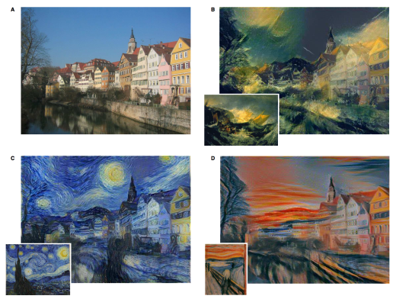
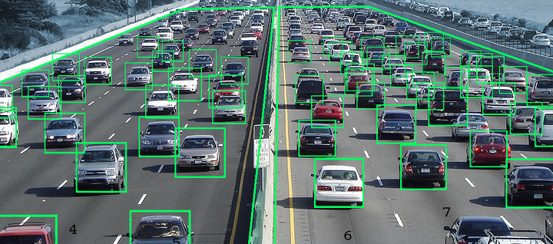
Deep Learning: Vision
Visual Learning
Object Recognition
Style Transfer
Deblurring and Denoising
Super-Resolution
…

Slide 7

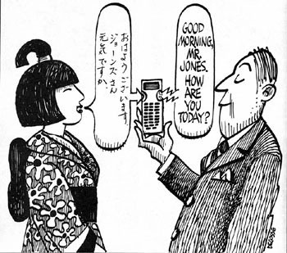

Deep Learning: Speech and Languages
Speech/Language Learning
Speech Recognition
Machine Translation
Information Retrieval
…

Slide 8
Deep Learning Theory and Software Introduction Python/TensorFlow/Keras Installation
AI, Machine Learning, and Deep Learning
Python/TensorFlow/Keras Installation
Python/TensorFlow Examples

Slide 9
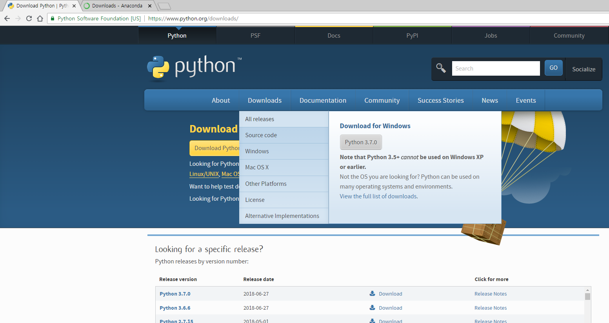
Python/TensorFlow/Keras Installation
Python/TensorFlow Installation: Python
www.python.org/downloads
python-3.5.3

Slide 10
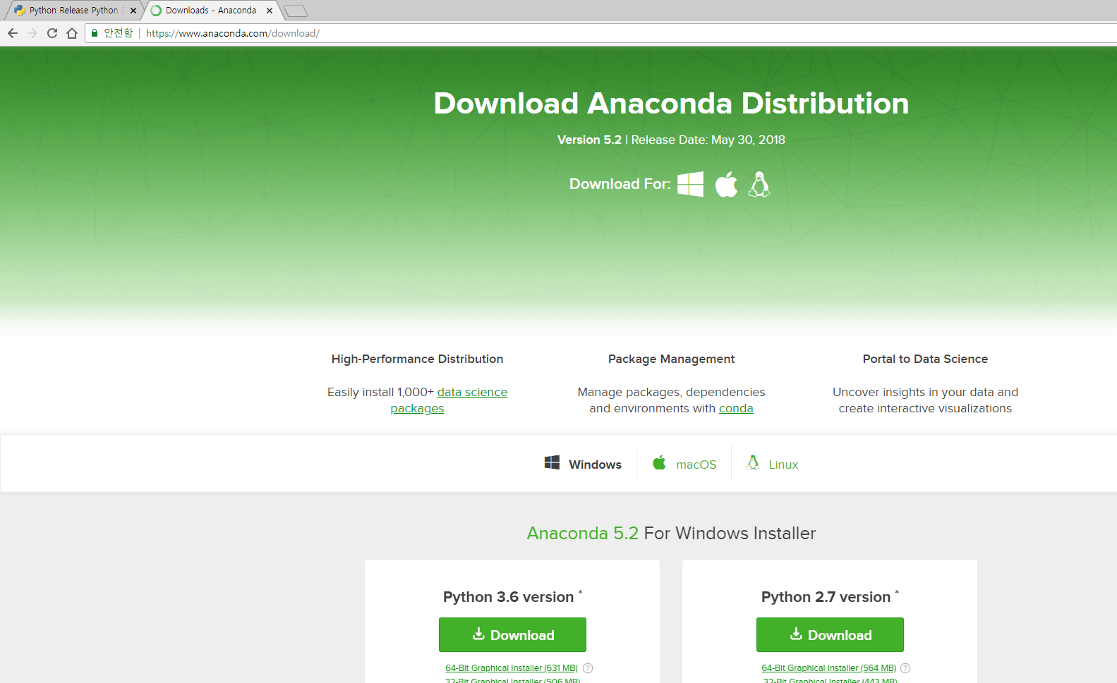
Python/TensorFlow/Keras Installation
Python/TensorFlow Installation: Anaconda
www.anaconda.com/download
Anaconda3-5.2.0-Windows-x86_64

Slide 11
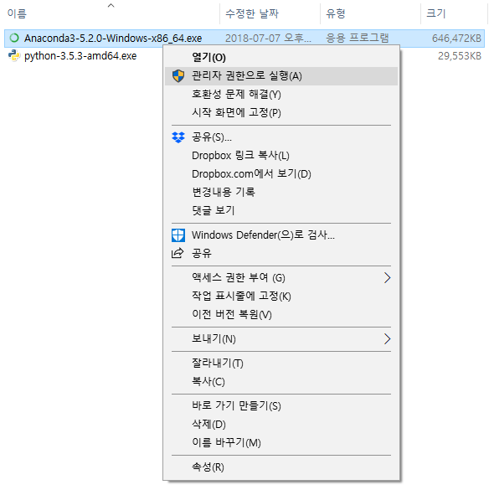
Python/TensorFlow/Keras Installation
Installation Procedure
[1] Conda Environment Setup
Execute the downloaded EXE as admin
[2] TensorFlow Installation

Slide 12
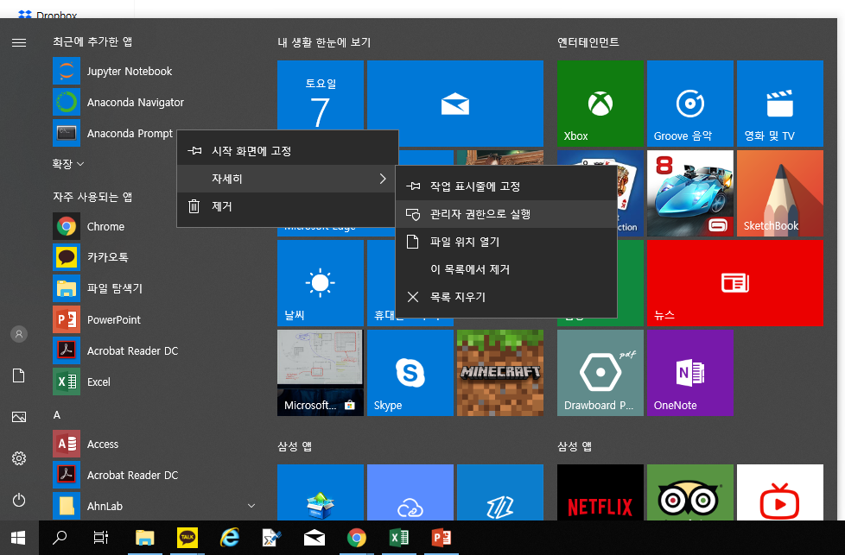
Python/TensorFlow/Keras Installation
Installation Procedure
[1] Conda Environment Setup
Execute Anaconda Prompt as admin
[2] TensorFlow Installation

Slide 13
Python/TensorFlow/Keras Installation
Installation Procedure
[1] Conda Environment Setup
[2] TensorFlow Installation
> conda create –n tensorflow python=3.5
Proceed([y]/n)? y
> pip install tensorflow
> pip install keras

Slide 14
Deep Learning Theory and Software Introduction Python/TensorFlow Examples
AI, Machine Learning, and Deep Learning
Python/TensorFlow/Keras Installation
Python/TensorFlow Examples

Slide 15
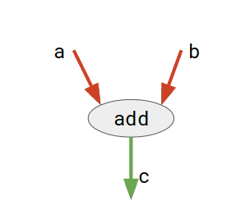
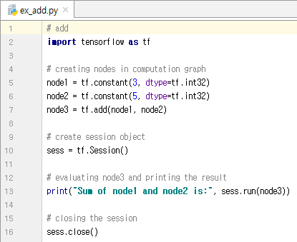
Python/TensorFlow Examples
Quick Start Example
add is a node which represents addition operation
a and b: input tensors
c: resultant tensor

Slide 16
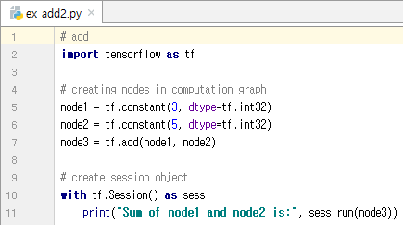
Python/TensorFlow Examples
Quick Start Example
The benefit of this approach is that you do not need to close the session explicitly as it gets automatically closed once control goes out of the scope of with block.

Slide 17
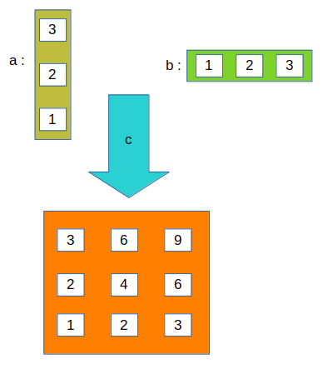
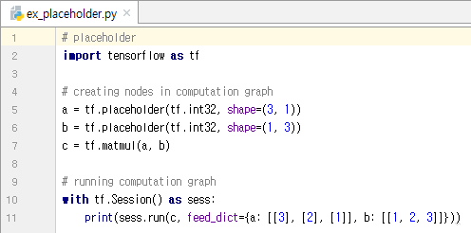
Python/TensorFlow Examples
Example: Placeholder

Slide 18
Deep Learning Theory and Software Linear Regression
Prof. Joongheon Kim School of Computer Science and Engineering, Chung-Ang University, Seoul, Korea https://sites.google.com/site/joongheonkim/ joongheon@gmail.com

Slide 19
Deep Learning Theory and Software Linear Regression Linear Regression Theory
Linear Regression Theory
Linear Regression Implementation

Slide 20

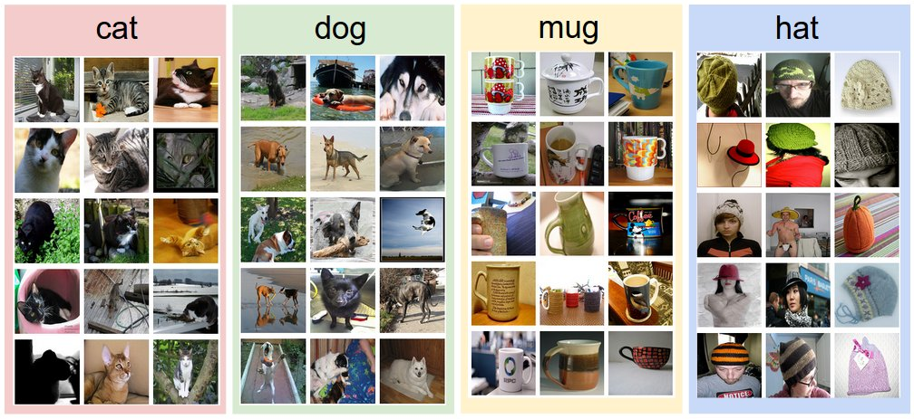

Regression and Classification
Regression (Examples)
Classification (Examples)
Exam Score Prediction (based on time)
Stock Price Prediction (based on time)
Pass/Fail (Binary Classification)
Letter Grades (Multi-Level Classification)

Slide 21

Linear Regression
Example (Exam Score Prediction)
5 Hours
60
x (Hour) | y (Score)
1 | 10
2 | 15
3 | 40
Regression
Engine

Slide 22
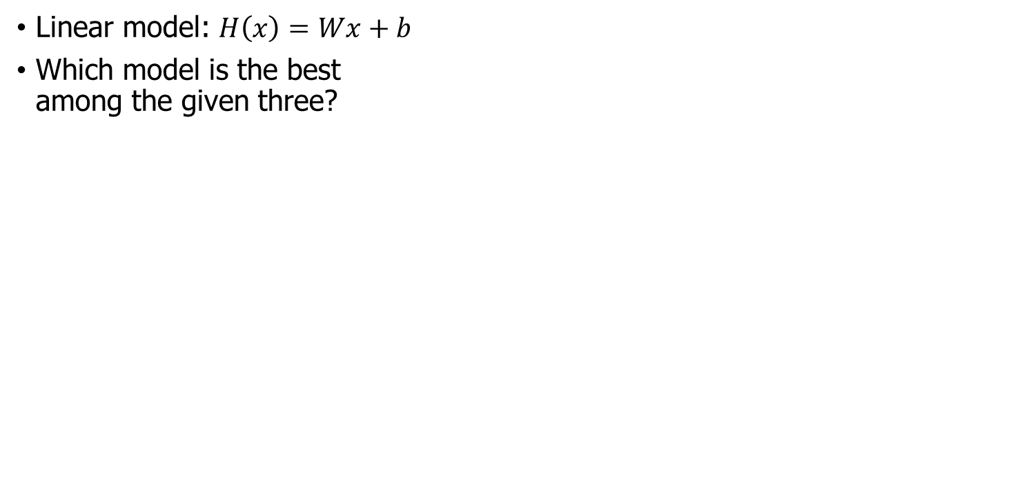
Linear Regression
Linear model: $H\left(x\right)=Wx+b$
Which model is the best among the given three?
y
40
30
20
x | y
1 | 10
2 | 15
3 | 40
10
1
2
3
x

Slide 23
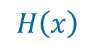

Linear Regression
Cost Function (or Loss Function)
How to fit the line to training data
The difference between model values and real measurements:
$$H\left(x\right)$$
y
40
$${\left(H\left(x\right)−y\right)}^{2}$$
30
20
x | y
1 | 10
2 | 15
3 | 40
10
1
2
3
x

Slide 24
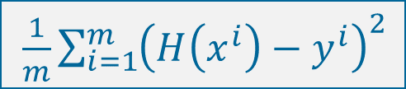
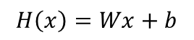
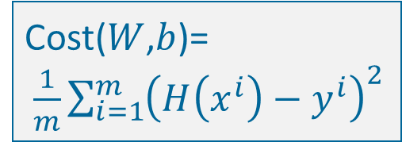
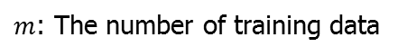
Linear Regression
Cost Function (or Loss Function)
Cost
$$H\left(x\right)$$
y
40
$m$: The number of training data
$\frac{1}{m}\sum_{i=1}^{m}{{\left(H\left(x^{i}\right)−y^{i}\right)}^{2}}$
30
$$H\left(x\right)=Wx+b$$
20
Cost($W$,$b$)= $\frac{1}{m}\sum_{i=1}^{m}{{\left(H\left(x^{i}\right)−y^{i}\right)}^{2}}$
x | y
1 | 10
2 | 15
3 | 40
10
1
2
3
x

Slide 25
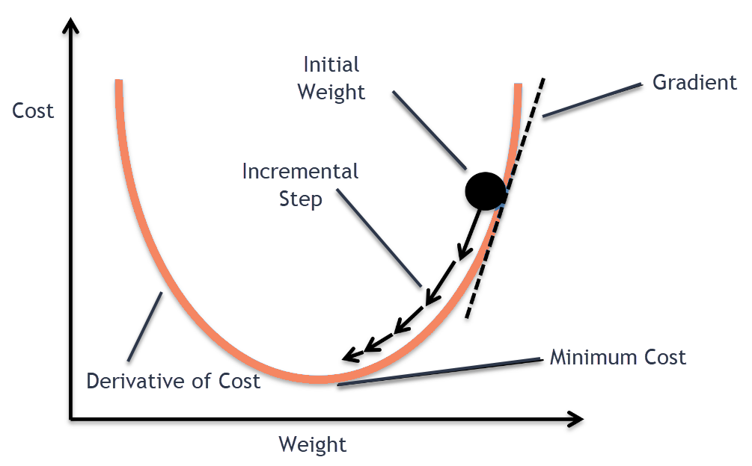
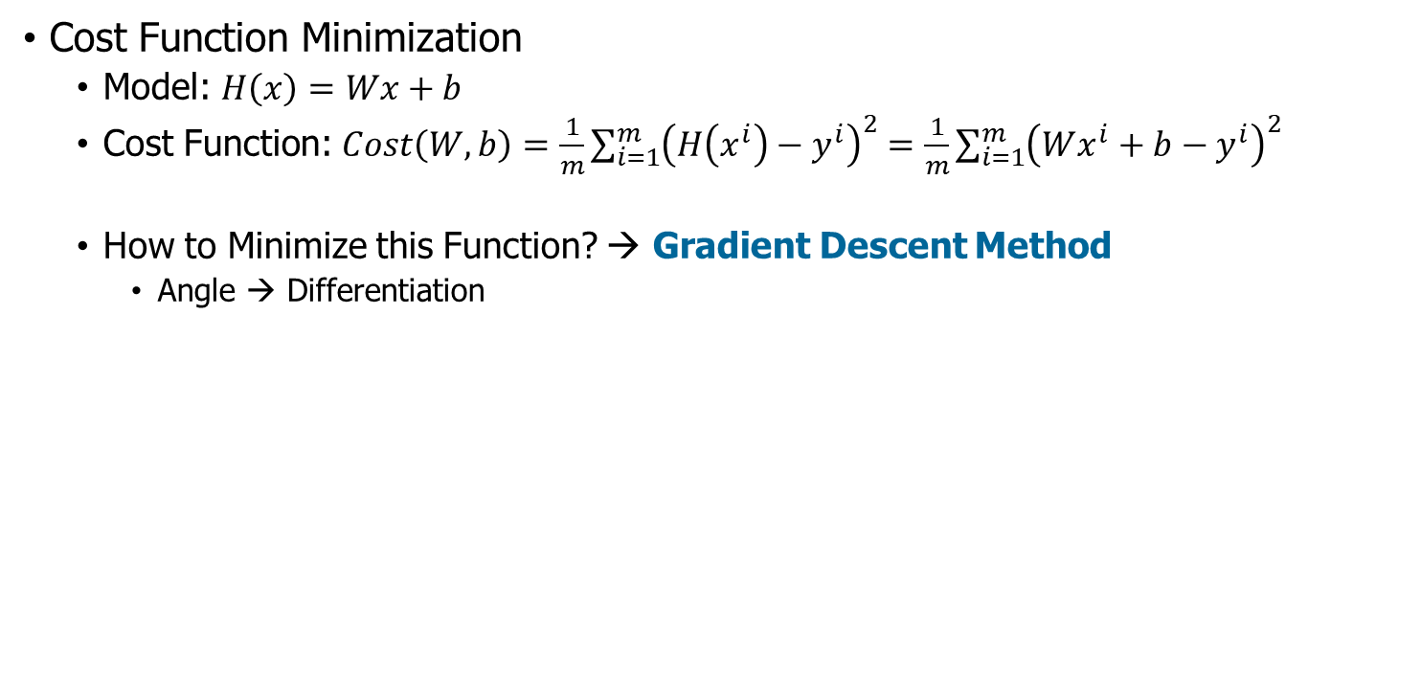
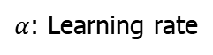
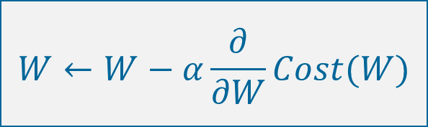
Linear Regression
Cost Function Minimization
Model: $H\left(x\right)=Wx+b$
Cost Function: $Cost\left(W,b\right)=\frac{1}{m}\sum_{i=1}^{m}{{\left(H\left(x^{i}\right)−y^{i}\right)}^{2}}=\frac{1}{m}\sum_{i=1}^{m}{{\left(Wx^{i}+b−y^{i}\right)}^{2}}$
How to Minimize this Function? → Gradient Descent Method
Angle → Differentiation
$$W←W−α\frac{∂}{∂W}Cost(W)$$
$α$: Learning rate

Slide 26
Linear Regression
Learning Rates
Too large: Overshooting
Too small: takes too long, stops at local minimum
How can we determine the learning rates?
Try several learning rates
Observe the cost function
Check it goes down in a reasonable rate

Slide 27
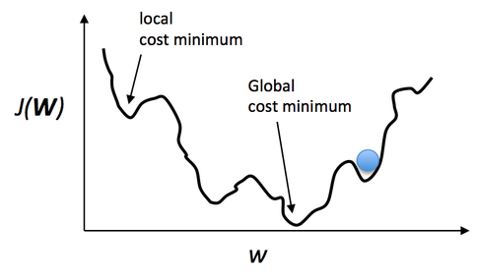
Linear Regression
Cost Function Minimization
Gradient Descent Method is only good for convex functions.

Slide 28
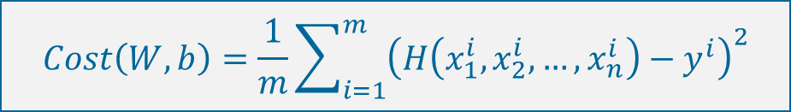
Linear Regression
Multi-Variable Linear Regression
Model:
Cost:
$$H\left(x_{1},x_{2},…,x_{n}\right)=w_{1}x_{1}+w_{2}x_{2}+…+w_{n}x_{n}+b$$
$$Cost\left(W,b\right)=\frac{1}{m}\sum_{i=1}^{m}{{\left(H\left(x_{1}^{i},x_{2}^{i},…,x_{n}^{i}\right)−y^{i}\right)}^{2}}$$

Slide 29
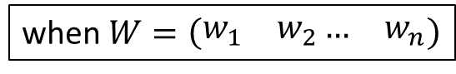
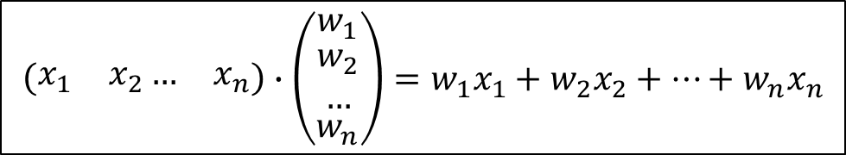



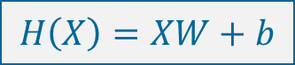
Linear Regression
Multi-Variable Linear Regression
Model:
$$H\left(x_{1},x_{2},…,x_{n}\right)=w_{1}x_{1}+w_{2}x_{2}+…+w_{n}x_{n}+b$$
$$H\left(X\right)=XW+b$$
$$\left(\begin{matrix}x_{1} & x_{2}… & x_{n}\end{matrix}\right)∙\left(\begin{matrix}w_{1} \\ \begin{aligned}w_{2} \\ …\end{aligned} \\ w_{n}\end{matrix}\right)=w_{1}x_{1}+w_{2}x_{2}+…+w_{n}x_{n}$$
$$X$$
$$W$$
$$H\left(X\right)=XW^{T}+b$$
when $W=\left(\begin{matrix}w_{1} & w_{2}… & w_{n}\end{matrix}\right)$

Slide 30
Deep Learning Theory and Software Linear Regression Linear Regression Implementation
Linear Regression Theory
Linear Regression Implementation

Slide 31
Linear Regression Implementation (TensorFlow)
TensorFlow
Linear Regression with Two-Dimensional Data
Linear Regression with Two-Dimensional Data (using Placeholder)
Linear Regression with High-Dimensional Data
Keras
Linear Regression

Slide 32
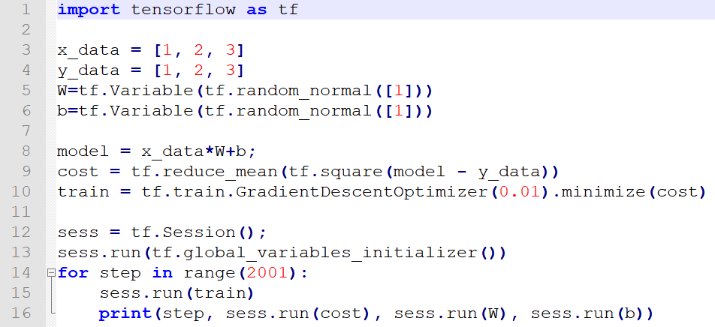
Linear Regression Implementation (TensorFlow)

Slide 33
Linear Regression Implementation (TensorFlow)
Import TensorFlow library in Python

Slide 34
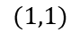
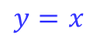
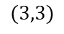
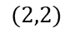
Linear Regression Implementation (TensorFlow)
Training Data Definition
Input Data: (1, 1), (2, 2), and (3, 3)
$$(3,3)$$
$$(2,2)$$
$$(1,1)$$
$$y=x$$

Slide 35
Linear Regression Implementation (TensorFlow)
Defining W and b for Linear Regression
W: weight
b: bias
Defining variables: Variable(<initial-value>,name=<optional-name>)
Initializing W and b with random numbers: random_normal([1]) // 1-by-1 matrix

Slide 36
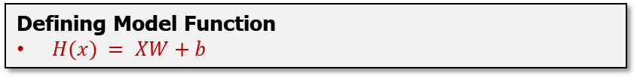
Linear Regression Implementation (TensorFlow)
Defining Model Function
$H(x) = XW+b$

Slide 37
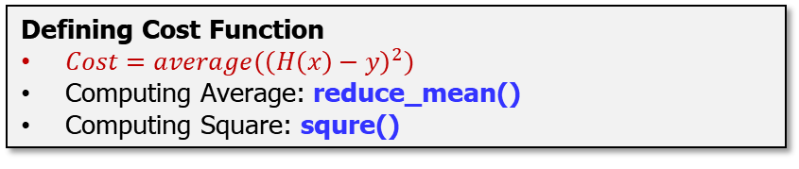
Linear Regression Implementation (TensorFlow)
Defining Cost Function
$Cost=average({\left(H\left(x\right)−y\right)}^{2})$
Computing Average: reduce_mean()
Computing Square: squre()

Slide 38
Linear Regression Implementation (TensorFlow)
Designing Optimization Framework
Optimization based on Gradient Descent Method: GradientDescentOptimizer(learning_rate=0.01)
Minimization of Cost Function: minimize(cost)

Slide 39
Linear Regression Implementation (TensorFlow)
Session Run
Session initiation: Session()
Execution: run() in Session(), i.e., sess.run()
Setting the Global Initial Values: global_variables_initializer()
Gradient Descent Method Runs for Multiple Times: for step in range(2001)
Running Session: sess.run(train)
Printing the Computation Results: sess.run(cost), sess.run(W), sess.run(b)

Slide 40
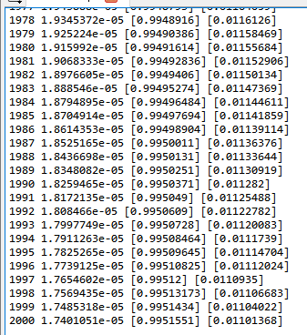
Linear Regression Implementation (TensorFlow)

Slide 41
Linear Regression Implementation (TensorFlow)
TensorFlow
Linear Regression with Two-Dimensional Data
Linear Regression with Two-Dimensional Data (using Placeholder)
Linear Regression with High-Dimensional Data
Keras
Linear Regression

Slide 42
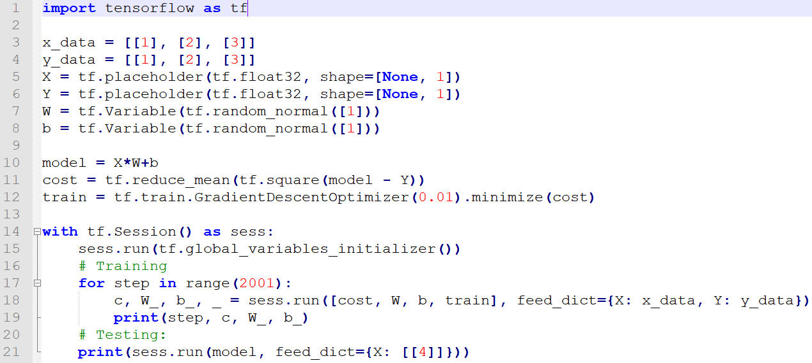
Linear Regression Implementation (TensorFlow)

Slide 43
Linear Regression Implementation (TensorFlow)
Defining Placeholder: X and Y
Placeholder: Variables which contain training set data
Data Type: float32
Shape: not determined

Slide 44
Linear Regression Implementation (TensorFlow)
Iteration
c, W_, b_, _ = sess.run([cost, W, b, train], feed_dict={X:x_data, Y:y_dat})
c: var for cost value in training
W_: var for W value in training
b_: var for b value in training
feed_dict: input values for placeholders X and Y

Slide 45
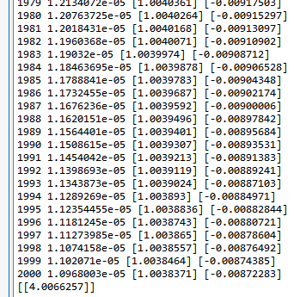
Linear Regression Implementation (TensorFlow)

Slide 46
Linear Regression Implementation (TensorFlow)
TensorFlow
Linear Regression with Two-Dimensional Data
Linear Regression with Two-Dimensional Data (using Placeholder)
Linear Regression with High-Dimensional Data
Keras
Linear Regression

Slide 47
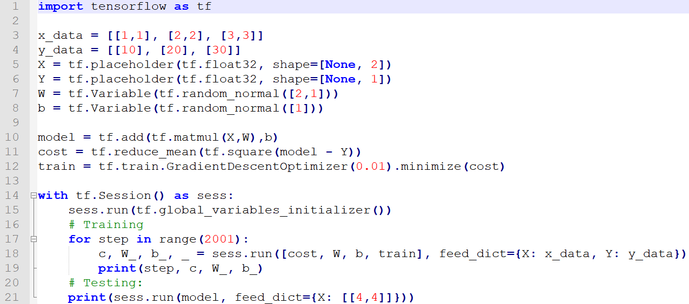
Linear Regression Implementation (TensorFlow)

Slide 48
Linear Regression Implementation (TensorFlow)
Training Data Definition
Input Data: (1,1,10), (2,2,20), (3,3,30)
Defining Placeholder: X and Y
Defining W and b for Linear Regression

Slide 49
Linear Regression Implementation (TensorFlow)
Model Definition
Matrix multiplication: matmul (X, W)
Defining Cost Function
Executing Optimization

Slide 50
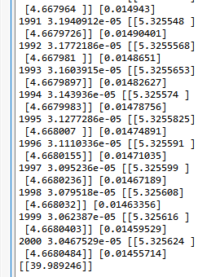
Linear Regression Implementation (TensorFlow)

Slide 51
Linear Regression Implementation (Keras)
TensorFlow
Linear Regression with Two-Dimensional Data
Linear Regression with Two-Dimensional Data (using Placeholder)
Linear Regression with High-Dimensional Data
Keras
Linear Regression

Slide 52
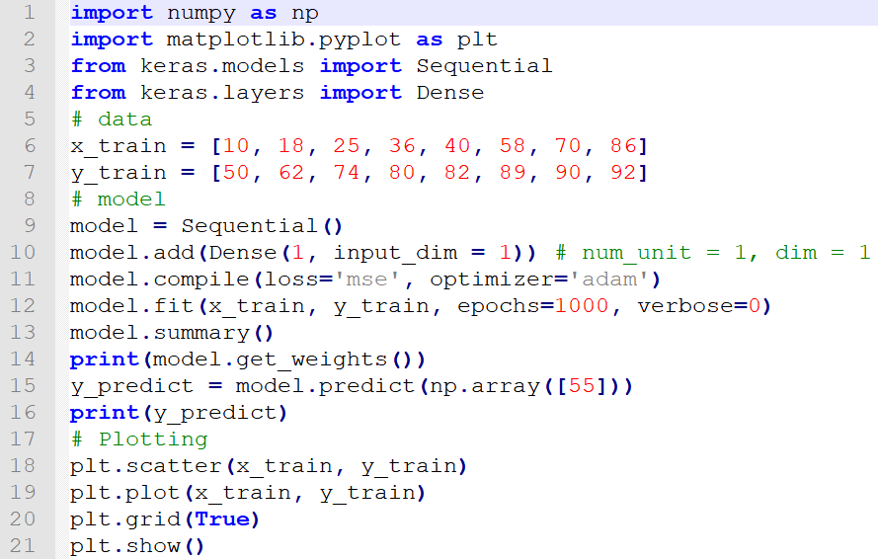
Linear Regression Implementation (Keras)

Slide 53
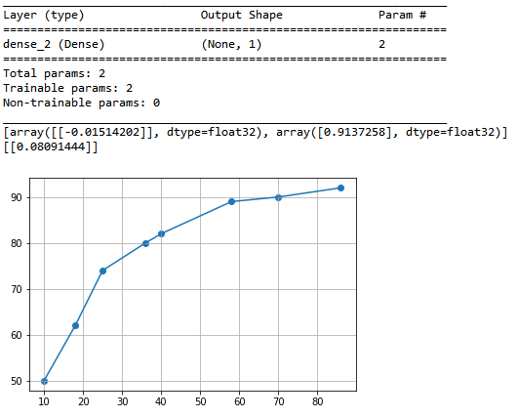
Linear Regression Implementation (Keras)

Slide 54
Deep Learning Theory and Software Binary Classification
Prof. Joongheon Kim School of Computer Science and Engineering, Chung-Ang University, Seoul, Korea https://sites.google.com/site/joongheonkim/ joongheon@gmail.com

Slide 55
Deep Learning Theory and Software Binary Classification Binary Classification Theory
Binary Classification Theory
Binary Classification Implementation

Slide 56
Regression and Classification
Regression (Examples)
Classification (Examples)
Exam Score Prediction (based on time)
Pass/Fail (Binary Classification)
Letter Grades (Multi-Level Classification)

Slide 57
Binary Classification
Binary Classification Examples
Spam Detection: Spam [1] or Ham [0]
Facebook Feed: Show [1] or Hide [0]
Facebook learns with your like-articles; and shows your favors.
Credit Card Fraudulent Transaction Detection: Fraud [1] or Legitimate [0]
Tumor Image Detection in Radiology: Malignant [1] or Benign [0]

Slide 58
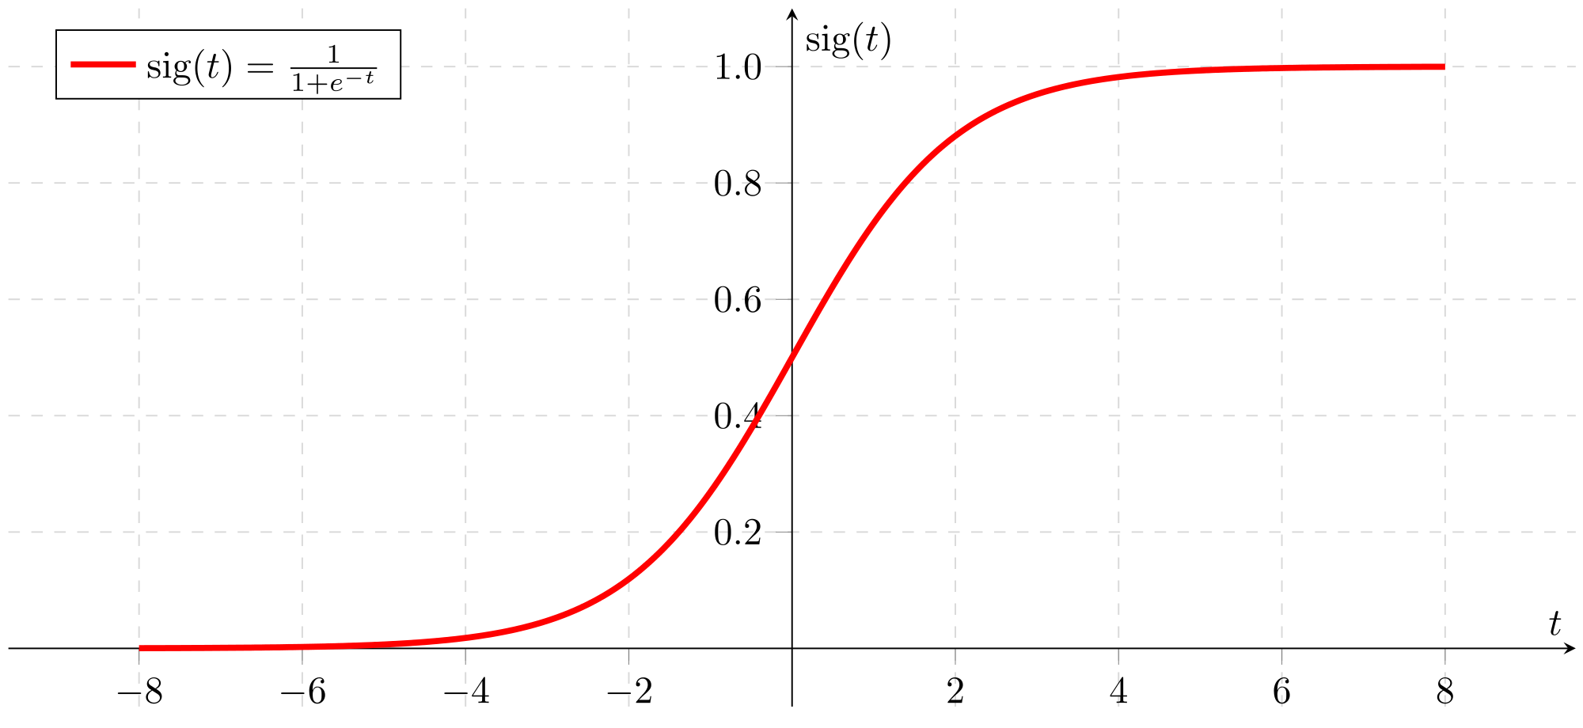
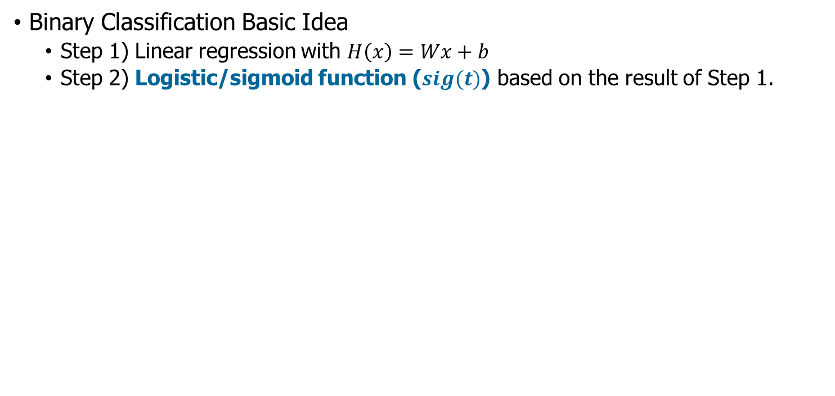
Binary Classification
Binary Classification Basic Idea
Step 1) Linear regression with $H\left(x\right)=Wx+b$
Step 2) Logistic/sigmoid function ($sig(t)$) based on the result of Step 1.

Slide 59

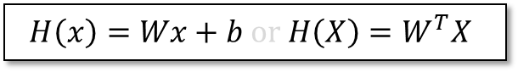

Binary Classification
Model
$$H\left(x\right)=Wx+b or H\left(X\right)=W^{T}X$$
Logistic Model
$$g\left(z\right)=\frac{1}{1+e^{−W^{T}X}}$$
Logistic/Sigmoid Function
$$g\left(z\right)=\frac{1}{1+e^{−z}}$$

Slide 60
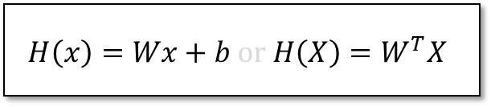
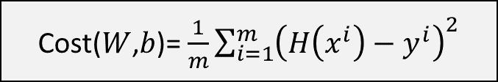
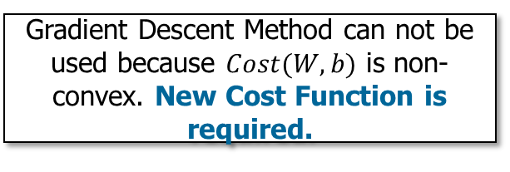
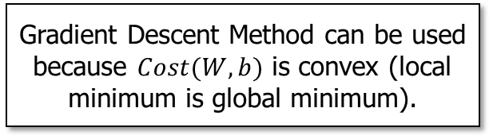

Binary Classification
Cost($W$,$b$)= $\frac{1}{m}\sum_{i=1}^{m}{{\left(H\left(x^{i}\right)−y^{i}\right)}^{2}}$
Hypothesis
Logistic Hypothesis
$$H\left(x\right)=Wx+b or H\left(X\right)=W^{T}X$$
$$g\left(z\right)=\frac{1}{1+e^{−W^{T}X}}$$
Gradient Descent Method can be used because $Cost(W,b)$ is convex (local minimum is global minimum).
Gradient Descent Method can not be used because $Cost(W,b)$ is non-convex. New Cost Function is required.

Slide 61
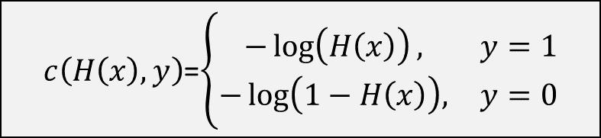


Binary Classification
Cost($W$)= $\frac{1}{m}\sum{c\left(H\left(x\right),y\right)}$
$c\left(H\left(x\right),y\right)$=$\left\{\begin{matrix}−\log\left(H\left(x\right)\right), & y=1 \\ −\log\left(1−H\left(x\right)\right), & y=0\end{matrix}\right.$
Understanding this Cost Function
Suppose that $y=1$,
If $H\left(x\right)=1$, then the cost should be $0$
If $H\left(x\right)=0$, then the cost should be very big, e.g., $∞$
Suppose that $y=0$,
If $H\left(x\right)=0$, then the cost should be $0$
If $H\left(x\right)=1$, then the cost should be very big, e.g., $∞$

Slide 62

Binary Classification
Cost($W$)= $\frac{1}{m}\sum{c\left(H\left(x\right),y\right)}$
$c\left(H\left(x\right),y\right)$=$\left\{\begin{matrix}−\log\left(H\left(x\right)\right), & y=1 \\ −\log\left(1−H\left(x\right)\right), & y=0\end{matrix}\right.$
$c\left(H\left(x\right),y\right)$=$−y\log\left(H\left(x\right)\right)−(1−y) \log\left(1−H\left(x\right)\right)$
$$Cost\left(W\right)=−\frac{1}{m}\sum{y\log\left(H\left(x\right)\right)+(1−y) \log\left(1−H\left(x\right)\right)}$$
Gradient Descent Method
$$W←W−α\frac{∂}{∂W}Cost(W)$$

Slide 63
Deep Learning Theory and Software Binary Classification Binary Classification Implementation
Binary Classification Theory
Binary Classification Implementation

Slide 64
Binary Classification Implementation (TensorFlow)
TensorFlow
Binary Classification
Binary Classification (using CSV File)
Keras
Binary Classification
Binary Classification (using CSV File)

Slide 65

Binary Classification Implementation (TensorFlow)

Slide 66

Binary Classification Implementation (TensorFlow)
Defining Model
$H(X)=\frac{1}{1+e^{−(WX+b)}}$
sigmoid(): sigmoid function
matmul(X, W): matrix multiplication of X & W
Defining Cost Function
$Cost=−\frac{1}{m}\sum{Y\log\left(H\left(X\right)\right)+(1−Y) \log\left(1−H\left(X\right)\right)}$
Executing Optimization

Slide 67
Binary Classification Implementation (TensorFlow)
Defining Session
Initiating the Session
Running with Global Initial Values
Iteration
c, _ = sess.run([cost, train], feed_dict={X:x_data, Y:y_data})
Printing model, predict, accuracy
Notes:
@

Slide 68
Binary Classification Implementation (TensorFlow)
Defining predict
Checking if the first argument of tf.cast is true or not.
If true (model > 0.5), the result of tf.cast is 1.0.
Otherwise, the result of tf.cast is 0.0.
Defining accuracy
tf.equal()
It returns True when predict == Y.
Otherwise, it returns False.
Accuracy: The average of T/F (= 1/0) values.

Slide 69

Binary Classification Implementation (TensorFlow)

Slide 70
Binary Classification Implementation (TensorFlow)
TensorFlow
Binary Classification
Binary Classification (using CSV File)
Keras
Binary Classification
Binary Classification (using CSV File)

Slide 71

Binary Classification Implementation (TensorFlow)
CSV file

Slide 72

Binary Classification Implementation (TensorFlow)

Slide 73

Binary Classification Implementation (TensorFlow)

Slide 74
Binary Classification Implementation (Keras)
TensorFlow
Binary Classification
Binary Classification (using CSV File)
Keras
Binary Classification
Binary Classification (using CSV File)

Slide 75

Binary Classification Implementation (Keras)

Slide 76

Binary Classification Implementation (Keras)

Slide 77
Binary Classification Implementation (Keras)
TensorFlow
Binary Classification
Binary Classification (using CSV File)
Keras
Binary Classification
Binary Classification (using CSV File)

Slide 78

Binary Classification Implementation (Keras)

Slide 79

Binary Classification Implementation (Keras)

Slide 80
Deep Learning Theory and Software Softmax Classification
Prof. Joongheon Kim School of Computer Science and Engineering, Chung-Ang University, Seoul, Korea https://sites.google.com/site/joongheonkim/ joongheon@gmail.com

Slide 81
Deep Learning Theory and Software Softmax Classification Softmax Classification Theory
Softmax Classification Theory
Softmax Classification Implementation

Slide 82
Regression and Classification
Regression (Examples)
Classification (Examples)
Exam Score Prediction (based on time)
Pass/Fail (Binary Classification)
Letter Grades (Multi-Level Classification)

Slide 83


Multinomial Classification (Softmax Classification)
$$x_{1}$$
A
A
B
B
C
$$x_{2}$$

Slide 84













Multinomial Classification (Softmax Classification)
$$x_{1}$$
$$x_{1}$$
$$x_{1}$$
A
A
A
A
A
A
C or not
B or not
B
B
B
A or not
B
B
B
C
C
C
$$x_{2}$$
$$x_{2}$$
$$x_{2}$$
$$X$$
$$W$$
$$\overline{Y}$$
$$X$$
$$W$$
$$\overline{Y}$$
$$X$$
$$W$$
$$\overline{Y}$$
A
B
C
A
B
C

Slide 85











Multinomial Classification (Softmax Classification)
PRPBABILITY
$$WX=\left(\begin{matrix}{\overline{Y}}_{A} \\ {\overline{Y}}_{B} \\ {\overline{Y}}_{C}\end{matrix}\right)$$
$$sigmoid(A)$$
$$p_{A}=0.7$$
$0≤p_{A},p_{B},p_{C}≤1$
$p_{A}+p_{B}+p_{C}=1$
A
A
Proportional Calculation
B
$$sigmoid(B)$$
B
$$p_{B}=0.2$$
C
$$sigmoid(C)$$
C
$$p_{C}=0.1$$
tensorflow.nn.softmax()
One-Hot Encoding (argmax)
A
$$1.0$$
B
$$0.0$$
A
C
$$0.0$$

Slide 86




Multinomial Classification (Softmax Classification)
Cost Function: Cross-Entropy
$S\left(Y\right)=\overline{Y}$ (estimated)
$L=Y$ (real)
$$D\left(S,L\right)=−\sum_{∀i}{L_{i}\log\left(S_{i}\right)}$$
0.7
0.2
0.1
1.0
0.0
0.0
Understanding this Cost Function
Suppose that $L=[1,0,0]$,
If $\overline{Y}=[1,0,0]$, then $D=−1∙\log{1}−0∙\log{0}−0∙\log{0}=−1∙0−0∙(−∞)−0∙(−∞)=0$ (no cost).
If $\overline{Y}=[0,1,0]$, then $D=−1∙\log{0}−0∙\log{1}−0∙\log{0}=−1∙(−∞)−0∙0−0∙(−∞)=∞$ (huge cost).
If $\overline{Y}=[0,0,1]$, then $D=−1∙\log{0}−0∙\log{0}−0∙\log{1}=−1∙(−∞)−0∙(−∞)−0∙0=∞$ (huge cost).

Slide 87
Deep Learning Theory and Software Softmax Classification Softmax Classification Implementation
Softmax Classification Theory
Softmax Classification Implementation

Slide 88












Softmax Classification Implementation (TensorFlow)
Implementation Example
$$x_{1}$$
$$x_{1}$$
$$x_{1}$$
A
A
A
A
A
A
B
C or not
B
B or not
B
A or not
B
B
B
C
C
C
$$x_{2}$$
$$x_{2}$$
$$x_{2}$$
$$X$$
$$W$$
$$\overline{Y}$$
$$X$$
$$W$$
$$\overline{Y}$$
$$X$$
$$W$$
$$\overline{Y}$$

Slide 89

Softmax Classification Implementation (TensorFlow)
Implementation Example
Vector Representation
A
B
C

Slide 90
Softmax Classification Implementation (TensorFlow)
TensorFlow
Softmax Classification
Softmax Classification (with Given Cost Function)
Keras
Softmax Classification

Slide 91

Softmax Classification Implementation (TensorFlow)

Slide 92
Softmax Classification Implementation (TensorFlow)

Slide 93
Softmax Classification Implementation (TensorFlow)
TensorFlow
Softmax Classification
Softmax Classification (with Given Cost Function)
Keras
Softmax Classification

Slide 94

Softmax Classification Implementation (TensorFlow)

Slide 95
Softmax Classification Implementation (TensorFlow)

Slide 96
Softmax Classification Implementation (Keras)
TensorFlow
Softmax Classification
Softmax Classification (with Given Cost Function)
Keras
Softmax Classification

Slide 97

Softmax Classification Implementation (Keras)

Slide 98

Softmax Classification Implementation (Keras)

Slide 99
Deep Learning Theory and Software Artificial Neural Networks (ANN)
Prof. Joongheon Kim School of Computer Science and Engineering, Chung-Ang University, Seoul, Korea https://sites.google.com/site/joongheonkim/ joongheon@gmail.com

Slide 100
Deep Learning Theory and Software Artificial Neural Networks (ANN) ANN Theory
ANN Theory
ANN Implementation

Slide 101


Artificial Neural Networks (ANN): Introduction
Human Brain (Neuron)
Binary Classification

Slide 102

Artificial Neural Networks (ANN): Multilayer Perceptron

Slide 103




Artificial Neural Networks (ANN): Multilayer Perceptron
Application to Logic Gate Design
What about XOR?
AND gate
OR gate
NOT gate

Slide 104



Artificial Neural Networks (ANN): Multilayer Perceptron
$$x_{1}$$
$$x_{1}$$ | $$x_{2}$$ | XOR
0 | 0 | 0
0 | 1 | 1
1 | 0 | 1
1 | 1 | 0
1
0
0
1
$$x_{2}$$
Mathematically proven by Prof. Marvin Minsky at MIT (1969)

Slide 105



Artificial Neural Networks (ANN): Multilayer Perceptron
Multilayer Perceptron (MLP)
Proposed by Prof. Marvin Minsky at MIT (1969)
Can solve XOR Problem
1st Layer
MLP
2nd Layer
MLP
3rd Layer
MLP

Slide 106















ANN: Solving XOR with MLP
$$x_{1}$$
$$x_{1}$$
$$y_{1}$$
$$y_{1}$$
$$y_{2}$$
$$\overline{y}$$
$$x_{2}$$
$$x_{2}$$
$$y_{2}$$
$$W=\left(\begin{matrix}5 \\ 5\end{matrix}\right), b=−8$$
$$W=\left(\begin{matrix}−7 \\ −7\end{matrix}\right), b=3$$
$$W=\left(\begin{matrix}−11 \\ −11\end{matrix}\right), b=6$$
$\left(x_{1} x_{2}\right)=\left(0 0\right)$
$\left(0 0\right)\left(\begin{matrix}5 \\ 5\end{matrix}\right)+\left(−8\right)=−8$, i.e., $y_{1}=Sigmoid\left(−8\right)≅0$
$\left(0 0\right)\left(\begin{matrix}−7 \\ −7\end{matrix}\right)+\left(3\right)=3$, i.e., $y_{2}=Sigmoid\left(3\right)≅1$
$\left(y_{1} y_{2}\right)\left(\begin{matrix}−11 \\ −11\end{matrix}\right)+\left(6\right)=−11+6=−5$, i.e., $\overline{y}=Sigmoid\left(−5\right)≅0$
$$x_{1}$$ | $$x_{2}$$ | $$y_{1}$$ | $$y_{2}$$ | $$\overline{y}$$ | XOR
0 | 0 | 0 | 1 | 0 | 0
0 | 1 |  |  |  | 1
1 | 0 |  |  |  | 1
1 | 1 |  |  |  | 0

Slide 107


ANN: Solving XOR with MLP
$$x_{1}$$
$$x_{1}$$
$$y_{1}$$
$$y_{1}$$
$$y_{2}$$
$$\overline{y}$$
$$x_{2}$$
$$x_{2}$$
$$y_{2}$$
$$W=\left(\begin{matrix}5 \\ 5\end{matrix}\right), b=−8$$
$$W=\left(\begin{matrix}−7 \\ −7\end{matrix}\right), b=3$$
$$W=\left(\begin{matrix}−11 \\ −11\end{matrix}\right), b=6$$
$\left(x_{1} x_{2}\right)=\left(0 1\right)$
$\left(0 1\right)\left(\begin{matrix}5 \\ 5\end{matrix}\right)+\left(−8\right)=−3$, i.e., $y_{1}=Sigmoid\left(−3\right)≅0$
$\left(0 1\right)\left(\begin{matrix}−7 \\ −7\end{matrix}\right)+\left(3\right)=−4$, i.e., $y_{2}=Sigmoid\left(−4\right)≅0$
$\left(y_{1} y_{2}\right)\left(\begin{matrix}−11 \\ −11\end{matrix}\right)+\left(6\right)=6$, i.e., $\overline{y}=Sigmoid\left(6\right)≅1$
$$x_{1}$$ | $$x_{2}$$ | $$y_{1}$$ | $$y_{2}$$ | $$\overline{y}$$ | XOR
0 | 0 | 0 | 1 | 0 | 0
0 | 1 | 0 | 0 | 1 | 1
1 | 0 |  |  |  | 1
1 | 1 |  |  |  | 0

Slide 108


ANN: Solving XOR with MLP
$$x_{1}$$
$$x_{1}$$
$$y_{1}$$
$$y_{1}$$
$$y_{2}$$
$$\overline{y}$$
$$x_{2}$$
$$x_{2}$$
$$y_{2}$$
$$W=\left(\begin{matrix}5 \\ 5\end{matrix}\right), b=−8$$
$$W=\left(\begin{matrix}−7 \\ −7\end{matrix}\right), b=3$$
$$W=\left(\begin{matrix}−11 \\ −11\end{matrix}\right), b=6$$
$\left(x_{1} x_{2}\right)=\left(1 0\right)$
$\left(1 0\right)\left(\begin{matrix}5 \\ 5\end{matrix}\right)+\left(−8\right)=−3$, i.e., $y_{1}=Sigmoid\left(−3\right)≅0$
$\left(1 0\right)\left(\begin{matrix}−7 \\ −7\end{matrix}\right)+\left(3\right)=−4$, i.e., $y_{2}=Sigmoid\left(−4\right)≅0$
$\left(y_{1} y_{2}\right)\left(\begin{matrix}−11 \\ −11\end{matrix}\right)+\left(6\right)=6$, i.e., $\overline{y}=Sigmoid\left(6\right)≅1$
$$x_{1}$$ | $$x_{2}$$ | $$y_{1}$$ | $$y_{2}$$ | $$\overline{y}$$ | XOR
0 | 0 | 0 | 1 | 0 | 0
0 | 1 | 0 | 0 | 1 | 1
1 | 0 | 0 | 0 | 1 | 1
1 | 1 |  |  |  | 0

Slide 109


ANN: Solving XOR with MLP
$$x_{1}$$
$$x_{1}$$
$$y_{1}$$
$$y_{1}$$
$$y_{2}$$
$$\overline{y}$$
$$x_{2}$$
$$x_{2}$$
$$y_{2}$$
$$W=\left(\begin{matrix}5 \\ 5\end{matrix}\right), b=−8$$
$$W=\left(\begin{matrix}−7 \\ −7\end{matrix}\right), b=3$$
$$W=\left(\begin{matrix}−11 \\ −11\end{matrix}\right), b=6$$
$\left(x_{1} x_{2}\right)=\left(1 1\right)$
$\left(1 1\right)\left(\begin{matrix}5 \\ 5\end{matrix}\right)+\left(−8\right)=2$, i.e., $y_{1}=Sigmoid\left(2\right)≅1$
$\left(1 1\right)\left(\begin{matrix}−7 \\ −7\end{matrix}\right)+\left(3\right)=−11$, i.e., $y_{2}=Sigmoid\left(−11\right)≅0$
$\left(y_{1} y_{2}\right)\left(\begin{matrix}−11 \\ −11\end{matrix}\right)+\left(6\right)=−5$, i.e., $\overline{y}=Sigmoid\left(−5\right)≅0$
$$x_{1}$$ | $$x_{2}$$ | $$y_{1}$$ | $$y_{2}$$ | $$\overline{y}$$ | XOR
0 | 0 | 0 | 1 | 0 | 0
0 | 1 | 0 | 0 | 1 | 1
1 | 0 | 0 | 0 | 1 | 1
1 | 1 | 1 | 0 | 0 | 0

Slide 110








ANN: Solving XOR with MLP (Forward Propagation)
$$x_{1}$$
S
$$y_{1}$$
$$W=\left(\begin{matrix}5 \\ 5\end{matrix}\right), b=−8$$
S
$$\overline{y}$$
$$W=\left(\begin{matrix}−7 \\ −7\end{matrix}\right), b=3$$
S
$$W=\left(\begin{matrix}−11 \\ −11\end{matrix}\right), b=6$$
$$y_{2}$$
$$x_{2}$$
S
Sigmoid Function

Slide 111


ANN: Solving XOR with MLP (Forward Propagation)
$$x_{1}$$
S
$$y_{1}$$
S
$$\overline{y}$$
S
$$y_{2}$$
$$x_{2}$$
S
$$y_{2}$$
K
K
S
S
$$y_{2}$$
Sigmoid Function

Slide 112
ANN: Solving XOR with MLP (Forward Propagation)
x
x
→
 |  |  | …
 |  |  | …
…
$$x_{1}$$
S
$$y_{1}$$
S
$$\overline{y}$$
S
$$y_{2}$$
$$x_{2}$$
S
$$y_{2}$$
K
K
S
S
$$y_{2}$$
Sigmoid Function

Slide 113












ANN: Solving XOR with MLP (Forward Propagation)
$$x_{1}$$
S
$$y_{1}$$
$$W=\left(\begin{matrix}5 \\ 5\end{matrix}\right), b=−8$$
S
$$\overline{y}$$
$$W=\left(\begin{matrix}−7 \\ −7\end{matrix}\right), b=3$$
S
$$W=\left(\begin{matrix}−11 \\ −11\end{matrix}\right), b=6$$
$$y_{2}$$
$$x_{2}$$
S
$$K(X)$$
S
$$X$$
$$\overline{y}$$
$$W_{1}=\left(\begin{matrix}5 & −7 \\ 5 & −7\end{matrix}\right), B_{1}=\left(−8 3\right)$$
$$W=\left(\begin{matrix}−11 \\ −11\end{matrix}\right), b=6$$

Slide 114






ANN: Solving XOR with MLP (Forward Propagation)
S
$$K(X)$$
S
$$X$$
$$y_{1}$$
$$\overline{y}$$
$$W_{1}=\left(\begin{matrix}5 & −7 \\ 5 & −7\end{matrix}\right), B_{1}=\left(−8 3\right)$$
$$W=\left(\begin{matrix}−11 \\ −11\end{matrix}\right), b=6$$
$$K\left(X\right)=Sigmoid\left(XW_{1}+B_{1}\right)$$
$$\overline{Y}=H\left(X\right)=Sigmoid\left(K\left(X\right)W+b\right)$$

Slide 115


TensorFlow for ANN (XOR with Logistic Regression)

Slide 116

Keras for ANN (XOR with Logistic Regression)

Slide 117

Keras for ANN (XOR with Logistic Regression)

Slide 118







TensorFlow for ANN (XOR with ANN)
W
S
$$K(X)$$
W
S
$$X$$
$$\overline{y}$$
$$K\left(X\right)=Sigmoid\left(XW_{1}+B_{1}\right)$$
$$\overline{Y}=H\left(X\right)=Sigmoid\left(K\left(X\right)W+b\right)$$

Slide 119

Keras for ANN (XOR with ANN)

Slide 120

Keras for ANN (XOR with ANN)

Slide 121
TensorFlow for ANN (XOR with ANN)
Wide ANN for XOR
W1 = tf.Variable(tf.random_normal([2, 10]), name='weight1')
b1 = tf.Variable(tf.random_normal([10]), name='bias1')
layer1 = tf.sigmoid(tf.matmul(X, W1) + b1)
W2 = tf.Variable(tf.random_normal([10, 1]), name='weight2')
b2 = tf.Variable(tf.random_normal([1]), name='bias2')
hypothesis = tf.sigmoid(tf.matmul(layer1, W2) + b2)
[2,10], [10,1]
Hypothesis:
[[ 0.00358802]
[ 0.99366933]
[ 0.99204296]
[ 0.0095663 ]]
Correct:
[[ 0.]
[ 1.]
[ 1.]
[ 0.]]
Accuracy: 1.0
[2,2], [2,1]
Hypothesis:
[[ 0.01338218]
[ 0.98166394]
[ 0.98809403]
[ 0.01135799]]
Correct:
[[ 0.]
[ 1.]
[ 1.]
[ 0.]]
Accuracy: 1.0

Slide 122
TensorFlow for ANN (XOR with ANN)
Wide ANN for XOR
W1 = tf.Variable(tf.random_normal([2, 10]), name='weight1')
b1 = tf.Variable(tf.random_normal([10]), name='bias1')
layer1 = tf.sigmoid(tf.matmul(X, W1) + b1)
W2 = tf.Variable(tf.random_normal([10, 10]), name='weight2')
b2 = tf.Variable(tf.random_normal([10]), name='bias2')
layer2 = tf.sigmoid(tf.matmul(layer1, W2) + b2)
W3 = tf.Variable(tf.random_normal([10, 10]), name='weight3')
b3 = tf.Variable(tf.random_normal([10]), name='bias3')
layer3 = tf.sigmoid(tf.matmul(layer2, W3) + b3)
W4 = tf.Variable(tf.random_normal([10, 1]), name='weight4')
b4 = tf.Variable(tf.random_normal([1]), name='bias4')
hypothesis = tf.sigmoid(tf.matmul(layer3, W4) + b4)
4 layers
Hypothesis:
[[ 7.80e-04]
[ 9.99e-01]
[ 9.98e-01]
[ 1.55e-03]]
Correct:
[[ 0.]
[ 1.]
[ 1.]
[ 0.]]
Accuracy: 1.0
2 layers
Hypothesis:
[[ 0.01338218]
[ 0.98166394]
[ 0.98809403]
[ 0.01135799]]
Correct:
[[ 0.]
[ 1.]
[ 1.]
[ 0.]]
Accuracy: 1.0

Slide 123




ANN: ReLU (Rectified Linear Unit)
Activation Function
ANN for XOR Problem
Observation)
There exists cases when the accuracy is low even if the # layers is high. Why?
Answer)
The result of one ANN is the result of sigmoid function (between 0 and 1).
The numerous multiplication of this result converges to near zero. → Gradient Vanishing Problem
S
$$K(X)$$
S
$$X$$
$$y_{1}$$
$$\overline{y}$$
$$W_{1}=\left(\begin{matrix}5 & −7 \\ 5 & −7\end{matrix}\right), B_{1}=\left(−8 3\right)$$
$$W=\left(\begin{matrix}−11 \\ −11\end{matrix}\right), b=6$$

Slide 124

ANN: ReLU (Rectified Linear Unit)

Slide 125

ANN: ReLU (Rectified Linear Unit)
Cost Function of ReLU

Slide 126
TensorFlow for ANN
ReLU
# input place holders
X = tf.placeholder(tf.float32, [None, 784])
Y = tf.placeholder(tf.float32, [None, 10])
# weights & bias for nn layers
W1 = tf.Variable(tf.random_normal([784, 256]))
b1 = tf.Variable(tf.random_normal([256]))
L1 = tf.nn.relu(tf.matmul(X, W1) + b1)
W2 = tf.Variable(tf.random_normal([256, 256]))
b2 = tf.Variable(tf.random_normal([256]))
L2 = tf.nn.relu(tf.matmul(L1, W2) + b2)
W3 = tf.Variable(tf.random_normal([256, 10]))
b3 = tf.Variable(tf.random_normal([10]))
model_LC = tf.matmul(L2, W3) + b3
# define cost/loss & optimizer
cost = tf.reduce_mean(tf.nn.softmax_cross_entropy_with_logits_v2(logits=model_LC, labels=Y))
optimizer = tf.train.AdamOptimizer(0.01).minimize(cost)

Slide 127





ANN: Deep Learning
Why deeper was not better?
Our labeled datasets were too small.
Our computers were millions of times too slow.
Big-Data
GPU
We initialized the weights in a stupid way.
We used the wrong type of non-linearity (activation function).
Normalized Initiation
Initiation by Pre-trained Model
Using ReLU for solving Gradient Vanishing Problem

Slide 128
Deep Learning Theory and Software Artificial Neural Networks (ANN) ANN Implementation
ANN Theory
ANN Implementation

Slide 129
ANN Implementation (TensorFlow)
TensorFlow
MLP for MNIST
Keras
Multi-Layer Design
MLP for MNIST

Slide 130



TensorFlow: Source Code Review (MNIST Data Set Classification)
MNIST Data Set
Hand written images and their labels
For training: 55,000
For testing: 5,000
Image: 28-by-28 (pixels)
[0,0,0,0,0,1,0,0,0,0] → ‘5’
[1,0,0,0,0,0,0,0,0,0] → ‘0’
[0,0,0,0,1,0,0,0,0,0] → ‘4’
[0,1,0,0,0,0,0,0,0,0] → ‘1’

Slide 131

ANN Implementation (TensorFlow)

Slide 132

ANN Implementation (TensorFlow)

Slide 133

ANN Implementation (TensorFlow)
Line 48:
batch_train_images: matrix for mnist.train.next_batch: (batch_size)-by-(784) → image data
batch_train_labels: matrix for mnist.train.next_batch: (batch_size)-by-(10) → image labels
Line 54:
Testing with mnist.test.images and mnist.test.labels

Slide 134

ANN Implementation (TensorFlow)

Slide 135
ANN Implementation (Keras)
TensorFlow
MLP for MNIST
Keras
Multi-Layer Design
MLP for MNIST

Slide 136

ANN Implementation (Keras)

Slide 137

ANN Implementation (Keras)

Slide 138
ANN Implementation (Keras)
TensorFlow
MLP for MNIST
Keras
Multi-Layer Design
MLP for MNIST

Slide 139

ANN Implementation (Keras)

Slide 140
ANN Implementation (Keras)

Slide 141

ANN Implementation (Keras)

Slide 142
Deep Learning Theory and Software Convolutional Neural Networks (CNN)
Prof. Joongheon Kim School of Computer Science and Engineering, Chung-Ang University, Seoul, Korea https://sites.google.com/site/joongheonkim/ joongheon@gmail.com

Slide 143
Deep Learning Theory and Software Convolutional Neural Networks (CNN) CNN Theory
CNN Theory
CNN Implementation

Slide 144

CNN: Convolution
Notes:
Convolution 과 Pooling 을 반복해서 다차원 데이터를 1차원으로 만들어줌.

Slide 145

CNN: Convolution
Extracting one point with a filter
$$Wx+b$$
$$Y=w_{1}x_{1}+w_{2}x_{2}+…+w_{n}x_{n}+b$$

Slide 146



CNN: Convolution

Slide 147


CNN: Convolution

Slide 148

CNN: Convolution

Slide 149

CNN: Convolution

Slide 150
CNN: Convolution
Image Size: 7-by-7
Filter Size: 3-by-3
Strides (step-size of filter moving)
1: 5*5=25
2: 3*3=9
…
→ Large strides loose information (value degrades).

Slide 151
CNN: Convolution
Padding
Marking for the image areas
Preventing the case where the sizes of return images becomes smaller.
0 | 0 | 0 | 0 | 0 | 0 | 0 | 0 | 0
0 |  |  |  |  |  |  |  | 0
0 |  |  |  |  |  |  |  | 0
0 |  |  |  |  |  |  |  | 0
0 |  |  |  |  |  |  |  | 0
0 |  |  |  |  |  |  |  | 0
0 |  |  |  |  |  |  |  | 0
0 |  |  |  |  |  |  |  | 0
0 | 0 | 0 | 0 | 0 | 0 | 0 | 0 | 0

Slide 152

CNN: Convolution
From one image, multiple filters can be used for swiping the entire image.

Slide 153

CNN: Max Pooling
Pooling Layer (Sampling)

Slide 154

CNN: Max Pooling
Max Pooling Concept

Slide 155
CNN: Max Pooling

Slide 156

CNN: Example
Output Vector
(4x4)x8 = 128
Fully Connected
Layer

Slide 157

CNN: 3D
3D Convolution

Slide 158
Deep Learning Theory and Software Convolutional Neural Networks (CNN) CNN Implementation
CNN Theory
CNN Implementation

Slide 159

CNN Implementation (TensorFlow)
CNN for MNIST Image Classification

Slide 160

CNN Implementation (TensorFlow)
A
B
C
A
B
C

Slide 161
CNN Implementation (TensorFlow)
TensorFlow
CNN for MNIST
CNN for MNIST (with tensorflow.layers)
CNN/MLP for MNIST (with tensorflow.layers)
Keras
CNN for MNIST

Slide 162

CNN Implementation (TensorFlow)

Slide 163

CNN Implementation (TensorFlow)

Slide 164
CNN Implementation (TensorFlow)
TensorFlow
CNN for MNIST
CNN for MNIST (with tensorflow.layers)
CNN/MLP for MNIST (with tensorflow.layers)
Keras
CNN for MNIST

Slide 165

CNN Implementation (TensorFlow)

Slide 166

CNN Implementation (TensorFlow)

Slide 167
CNN Implementation (TensorFlow)
TensorFlow
CNN for MNIST
CNN for MNIST (with tensorflow.layers)
CNN/MLP for MNIST (with tensorflow.layers)
Keras
CNN for MNIST

Slide 168
CNN Implementation (TensorFlow)

Slide 169

CNN Implementation (TensorFlow)

Slide 170
CNN Implementation (Keras)
TensorFlow
CNN for MNIST
CNN for MNIST (with tensorflow.layers)
CNN/MLP for MNIST (with tensorflow.layers)
Keras
CNN for MNIST

Slide 171

CNN Implementation (Keras)

Slide 172
CNN Implementation (Keras)

Slide 173

CNN Implementation (Keras)

Slide 174
Deep Learning Theory and Software Cifar10
Prof. Joongheon Kim School of Computer Science and Engineering, Chung-Ang University, Seoul, Korea https://sites.google.com/site/joongheonkim/ joongheon@gmail.com

Slide 175
강의 개요
강의 목표 : MNIST보다 어려운 Cifar10 데이터셋과 함께 CNN 성능 향상 기법들을 이해하고 구현한다.
목차
1. Cifar10 Image Classification Dataset 소개
2. CNN 성능 향상을 위한 기법들
ReLU
Initializer
Optimizer
Batch Normalization
Dropout
Regularization (Advanced)
Data Augmentation
Ensemble
강의 진행 방식 : 기법 별 이론적 설명 (80%) -> 구현 (20%)

Slide 176
CIFAR10 Image Classification Dataset
목차
1. Cifar10 Image Classification Dataset 소개
2. CNN 성능 향상을 위한 기법들
ReLU
Initializer
Optimizer
Batch Normalization
Dropout
Regularization (Advanced)
Data Augmentation
Ensemble

Slide 177



CIFAR10 Image Classification Dataset
 | MNIST | CIFAR-10,100 | IMAGENET
Num Channel | 1 (Gray scale) | 3 (R, G, B) | 3 (R, G, B)
Num Classes | 10 | 10 , 100 | 1000
Resolution | 28 * 28 | 32 * 32 | (256 * 256)
Num Training Set | 50,000 | 50,000 | 200,000

Slide 178

CIFAR10 Image Classification Dataset
CIFAR 데이터 셋
32
3
32
RGB 3channel 컬러 이미지 이기 때문에 32* 32* 3 의 행렬로 표현

Slide 179

CIFAR10 Image Classification Dataset
CIFAR 데이터 셋 사용법
MNIST 데이터셋과 마찬가지로 라이브러리 지원.
케라스 설치 : pip install keras

Slide 180

CIFAR10 Image Classification Dataset
CIFAR 데이터 셋 사용법
CODE :
*데이터셋 저장 위치 : ~/.keras/datasets/

Slide 181

CIFAR10 Image Classification Dataset
CIFAR 데이터 셋 사용법
CODE :

Slide 182


CIFAR10 Image Classification Dataset
CIFAR 데이터 셋 Sample

Slide 183




CIFAR10 Image Classification Dataset
y_train, y_test onehot encoding
Code :
Output :
Keras dataset을 사용하는 경우 onehot encoding이 되어있지 않으므로 처리해주어야 한다

Slide 184

CIFAR10 Image Classification Dataset
CIFAR10 with Basic CNN

Slide 185

CIFAR10 Image Classification Dataset
CIFAR10 with Basic CNN

Slide 186
CIFAR10 Image Classification Dataset
CIFAR10 with Basic CNN
8, 8, 64
10
16, 16, 32
384
32, 32, 3
8 * 8 * 64

Slide 187

CIFAR10 Image Classification Dataset
CIFAR10 with Basic CNN

Slide 188

CIFAR10 Image Classification Dataset
CIFAR10 with Basic CNN

Slide 189

CIFAR10 Image Classification Dataset
CIFAR10 with Basic CNN

Slide 190

CIFAR10 Image Classification Dataset
CIFAR10 with Basic CNN

Slide 191
CNN 성능 향상 기법
목차
1. Cifar10 Image Classification Dataset 소개
2. CNN 성능 향상을 위한 기법들
ReLU
Initializer
Optimizer
Batch Normalization
Dropout
Regularization (Advanced)
Data Augmentation
Ensemble

Slide 192
CNN 성능 향상 기법 : Deeper Network
기존 Network
8, 8, 64
10
16, 16, 32
384
32, 32, 3
8 * 8 * 64
Deeper Network
2 * 2 * 512
8 * 8 * 128
4 * 4 * 256
10
32 * 32 * 3
16 * 16 * 64
1*512

Slide 193

CNN 성능 향상 기법 : Deeper Network

Slide 194
CNN 성능 향상 기법 : Deeper Network

Slide 195

CNN 성능 향상 기법 : Deeper Network
Deeper Network : Result
학습이 진행되지 않음.

Slide 196



CNN 성능 향상 기법 : Deeper Network
학습이 진행되지 않는 원인
경사 감소 소멸
역전파가 진행되는 과정에서 경사 (gradient) 가 0에 근접해버리는 문제
과 적합 ( Overfitting)
Training set의 노이즈에 까지 overfit 되어 test set 에 대한 정확도가 낮아지는 문제

Slide 197
CNN 성능 향상 기법 : Deeper Network
학습이 진행되지 않는 원인
경사 감소 소멸
역전파가 진행되는 과정에서 경사 (gradient) 가 0에 근접해버리는 문제
ReLU 활성화 함수, Batch normalization, Initializer
과 적합 ( Overfitting)
Training set의 노이즈에 까지 overfit 되어 test set 에 대한 정확도가 낮아지는 문제
Dropout , Ensemble

Slide 198



경사 감소 소멸
DNN review
Single Perceptron
Multi layer Perceptron
Deep neural Network
의의:
신경세포를 모방
And/or 문제 해결가능
한계:
XOR 문제 해결 불가능
의의:
Single Perceptron 을 여러 층 으로 쌓음
한계: 더 복잡한 문제를 해결하기 위해서는 더 깊은 신경망이 필요.
하지만 파라미터 수가 많아지면서 일반적은 경사감소법으로는 학습이 힘들어 짐
의의:
역전파 (Back propagation) 기법으로 많은 수의 파라미터도 학습 가능.
신경망이 깊어짐에 따라 더 복잡한 문제 해결 가능
=> 더욱더 복잡한 문제를 해결하려면?

Slide 199
경사 감소 소멸
DNN review
그러나 경사감소 소멸 문제로 인하여 신경망을 무한정 깊게 만들 수는 없다
표현력은 증가하나 학습이 불가능하다

Slide 200

경사 감소 소멸
경사 감소 소멸의 원인
?
!
역전파는 미분의 반복적 수행
하지만 연속적인 미분으로 경사(gradient)가 소멸되어 버려서 미처 최전단의 파라미터까지 학습이 되지 못함

Slide 201


경사 감소 소멸
경사 감소 소멸의 원인 : Sigmoid 활성화 함수
Sigmoid 활성화 함수는 이러한 경사감소를 가속화 시킨다.
(a) Sigmoid 함수의 미분
(b) Sigmoid 함수의 그래프
Sigmoid 함수는 미분할수록 그 값이 급격하게 작아진다

Slide 202

경사 감소 소멸
경사 감소 소멸의 원인 : Sigmoid 활성화 함수
해결 방안 1 : 활성화 함수를 사용하지 않는다. (불가능)
해결 방안 2 : Sigmoid의 역할을 하면서도 미분해도 값이 작아지지 않는 다른 활성화 함수를 사용한다.
=> ReLU 활성화 함수, tanh 활성화 함수

Slide 203
CNN 성능 향상 기법 : ReLU
목차
1. Cifar10 Image Classification Dataset 소개
2. CNN 성능 향상을 위한 기법들
ReLU
Initializer
Optimizer
Batch Normalization
Dropout
Regularization (Advanced)
Data Augmentation
Ensemble

Slide 204

CNN 성능 향상 기법 : ReLU
활성화 함수의 사용 이유 : 비선형성
(a) Perceptron
(b) 활성화 함수의 사용
Multi Layer Perceptron과 neural network의 차이는 활성화 함수의 사용 유무

Slide 205
CNN 성능 향상 기법 : ReLU
활성화 함수의 사용 이유 : 비선형성
(a) 선형
(b) 비선형
활성화 함수를 사용하지 않을 경우 단순히 w들의 곱일 뿐이게 된다 out = w_{n} * w_{n-1 …} * w₁ (x) = C * x <- [x에 대한 선형 함수]
따라서 활성화 함수를 사용하지 않을 경우 선형함수 밖에 표현할 수 없다

Slide 206

CNN 성능 향상 기법 : ReLU
활성화 함수의 사용 이유 : 비선형성
(a) 활성화 함수의 사용
(b) 복잡한 비선형 함수
활성화(비선형) 함수를 거치게 되면 더 복잡한 함수표현 가능 out = f(w_{n} * f(w_{n-1 …} * f(w₁ (x)))) = f f f f f f f (x) <- [x에 대한 비선형 함수]

Slide 207


CNN 성능 향상 기법 : ReLU
Sigmoid 활성화 함수의 사용 이유 : 계단함수
발화 구간
비발화 구간
역치값
(Threshold)
계단 함수는 신경세포의 역치의 개념과 같다

Slide 208


CNN 성능 향상 기법 : ReLU
Sigmoid 활성화 함수의 사용 이유 : 계단함수
실수 확률을 표현하기 위하여 누적 확률 분포 함수 사용
확률 함수로는 정규분포함수 사용
하지만 미분하기가 너무 어려워서 실제로 사용하기 까다로움

Slide 209


CNN 성능 향상 기법 : ReLU
Sigmoid 활성화 함수의 사용 이유 : 계단함수
Sigmoid 함수의 미분은 자기 자신으로
재귀적 표현 가능
따라서 미분은 훨씬 간단하지만 기능적으로는 거의 동일한 Sigmoid 함수를 개발

Slide 210
CNN 성능 향상 기법 : ReLU
Sigmoid 활성화 함수의 사용 이유 : 계단함수
하지만 Sigmoid 함수는 경사감소 소실 문제를 가속화 시킴
=> 따라서 아래와 같은 대체 가능한 함수 필요
1. 확률적 표현이 가능하고
2. 미분이 간단하고 3. 비선형 함수이며 4. 미분해도 값이 줄어들지 않아야 한다
=> 새로운 활성화 함수 tanh (hyperbolic tangent) 개발

Slide 211
CNN 성능 향상 기법 : ReLU
ReLU 활성화 함수
비선형 함수이다
계단함수로 사용 가능하다
미분이 간단하다
미분해도 경사 감소 문제가 발생하지 않는다
입력 값이 매우 커져도 경사 감소 문제가 발생하지 않는다

Slide 212

CNN 성능 향상 기법 : ReLU
Leaky ReLU
ReLU 함수의 장점을 살리고 단점을 보완하는 활성화 함수들이 개발 됨

Slide 213


CNN 성능 향상 기법 : ReLU
ReLU 함수 구현 및 결과
ReLU 함수 라이브러리 사용

Slide 214

CNN 성능 향상 기법 : ReLU
ReLU 함수 사용 구현 및 사용 결과
여전히 학습이 진행되지 않는다

Slide 215
CNN 성능 향상 기법 : Weight Initialization
목차
1. Cifar10 Image Classification Dataset 소개
2. CNN 성능 향상을 위한 기법들
ReLU
Initializer
Optimizer
Batch Normalization
Dropout
Regularization (Advanced)
Data Augmentation
Ensemble

Slide 216
CNN 성능 향상 기법 : Weight Initialization
가중치 초기화의 중요성
가중치가 너무 작거나 크면 Gradient는 0에 가까운 값을 가지게 되며 이 역시 경사 감소 소멸 현상의 원인이 된다.
따라서 활성화 함수를 개선하는 것 뿐만 아니라 가중치를 적절하게 초기화 하는 것을 통해서도 경사 감소 소멸 문제를 완화할 수 있다.

Slide 217
CNN 성능 향상 기법 : Weight Initialization
가중치 초기화의 중요성
가중치가 큰 경우 값이 과하게 분산될 수 있다
가중치가 작은 경우 값이 지나치게 0에 수렴할 수 있다

Slide 218

CNN 성능 향상 기법 : Weight Initialization
가중치 초기화의 방법
1. 정규 분포 확률로 초기화 – 평균0, 표준편차가 1
출력 값이 0과 1에 수렴

Slide 219

CNN 성능 향상 기법 : Weight Initialization
가중치 초기화의 방법
2. 작은 표준편차를 사용하여 초기화 – 평균0, 표준편차가 0.01 (기존 방법)

Slide 220

CNN 성능 향상 기법 : Weight Initialization
가중치 초기화의 방법
3. 발전된 방법 : Xavier Initialization
w = np.random.randn(n_input, n_output) / sqrt(n_input)
=> 단순히 작은 값의 표준편차를 갖는 형태로 초기화 하는 것이 아닌, 표준 정규 분포를 입력개수의 표준편차로 나누어 주는 방법을 사용

Slide 221
CNN 성능 향상 기법 : Weight Initialization
가중치 초기화의 방법
3. ReLU 함수에 맞는 초기화 방법 : He Initialization
w = np.random.randn(n_input, n_output) / sqrt(n_input/2)
Xavier Intialization 과 동일. 단지 인풋개수의 절반의 제곱근으로 나누어주는 차이가 있음
더 넓은 범위의 난수를 생성한다
하지만 Xavier Initializer로도 충분히 잘 학습된다

Slide 222
CNN 성능 향상 기법 : AdamOptimizer
목차
1. Cifar10 Image Classification Dataset 소개
2. CNN 성능 향상을 위한 기법들
ReLU
Initializer
Optimizer
Batch Normalization
Dropout
Regularization (Advanced)
Data Augmentation
Ensemble

Slide 223


CNN 성능 향상 기법 : AdamOptimizer
AdamOptimizer 사용

Slide 224


CNN 성능 향상 기법 : AdamOptimizer
Local minima
Local minima에 갇혀서 학습이 진행되지 않을 수 있다
그러나 최근 연구에 따르면 이러한 Local minima는 차원수가 증가함에 따라 기하급수적으로 등장확률이 희박해지며 대부분은 Saddle point 이기 때문에 크게 문제가 되지 않는다

Slide 225

CNN 성능 향상 기법 : AdamOptimizer
오차 곡면의 평평한 구간 문제
실제로는 경사가 작은 평평한 구간이 더욱 큰 문제로 작용
Local minimum
*Plateau with small gradient

Slide 226

CNN 성능 향상 기법 : AdamOptimizer
Momentum (관성)
진행 방향에 따른 Momentum (관성) 을 주어 경사가 급감해도 학습이 진행될 수 있도록 한다

Slide 227
CNN 성능 향상 기법 : AdamOptimizer
AdamOptimizer 사용

Slide 228

CNN 성능 향상 기법 : AdamOptimizer
ReLU + Xavier initializer + AdamOptimizer 성능 평가

Slide 229
CNN 성능 향상 기법 : Dataset Normalization
목차
1. Cifar10 Image Classification Dataset 소개
2. CNN 성능 향상을 위한 기법들
ReLU
Initializer
Optimizer
Batch Normalization
Dropout
Regularization (Advanced)
Data Augmentation
Ensemble

Slide 230

CNN 성능 향상 기법 : Dataset Normalization
Dataset Normalization (Input normalization) 이란
입력 값의 표준화를 통해서도 출력 값의 분산이 커지는 현상을 완화할 수 있다
값의 범위가 0~ 255 사이였던 기존 입력 값의 분포를 -1~1 사이로 표준화

Slide 231
CNN 성능 향상 기법 : Dataset Normalization
Dataset Normalization의 중요성
표준화가 되어있지 않은 경우
=> 출력 값의 분산이 커진다
표준화가 잘 되어있는 경우
=> 출력 값의 분산이 유지된다

Slide 232

CNN 성능 향상 기법 : Dataset Normalization
Dataset Normalization 구현

Slide 233

CNN 성능 향상 기법 : Dataset Normalization
Dataset Normalization 구현
(a) 기존 : 0~ 255 사이의 값
(b) 표준화 : -1~ 1 사이의 값

Slide 234
CNN 성능 향상 기법 : Batch Normalization
Batch Normalization 이란
표준화가 잘 되어있어도 레이어를 거치면서 어느정도는 흩어 질 수 있다.
=> 처음에는 어느정도 유지될 수 있지만
=> 흩어짐이 누적되면서 전체 결과에 영향을 줄 수 있다

Slide 235

CNN 성능 향상 기법 : Batch Normalization
Batch Normalization 이란
해결책 : 입력 데이터 뿐만 아니라 배치단위로 매 레이어에서 표준화를 한다
=> 매 레이어 마다 부분적으로 보정을 수행하여 전체적으로 왜곡이 일어나는 것을 방지

Slide 236

CNN 성능 향상 기법 : Batch Normalization
Batch Normalization 을 사용한 학습

Slide 237

CNN 성능 향상 기법 : Batch Normalization
Batch Normalization 을 사용한 학습

Slide 238
CNN 성능 향상 기법 : Batch Normalization
Batch Normalization 을 사용한 학습
입력값
Batch Normalization

Slide 239

CNN 성능 향상 기법 : Batch Normalization
Batch Normalization 을 사용한 테스트
학습시에는 미니 배치 별로 모멘텀을 저장
평가시에는 저장된 모멘텀의 평균을 사용

Slide 240

CNN 성능 향상 기법 : Batch Normalization
Batch Normalization 구현

Slide 241

CNN 성능 향상 기법 : Batch Normalization
Batch Normalization 구현

Slide 242
CNN 성능 향상 기법 : Dropout
목차
1. Cifar10 Image Classification Dataset 소개
2. CNN 성능 향상을 위한 기법들
ReLU
Initializer
Optimizer
Batch Normalization
Dropout
Regularization (Advanced)
Data Augmentation
Ensemble

Slide 243
CNN 성능 향상 기법 : Dropout
Overfitting 문제
Training set의 노이즈에 까지 overfit 되어 test set 에 대한 정확도가 낮아지는 문제
망이 깊어질 수록 (파라미터가 많아 질 수록) 심해진다

Slide 244
CNN 성능 향상 기법 : Dropout
Overfitting 문제
Overfitting 문제 해결을 위한 3가지 핵심 기법
1. 학습 데이터를 많이 확보한다 => Data augmentation 2. feature의 수를 줄이거나 여러 feature를 같이 사용한다
=> Dropout, Ensemble
3. 파라미터의 수를 줄인다 => Regularization

Slide 245

CNN 성능 향상 기법 : Dropout
Dropout
임의의 확률로 일부 neuron을 학습에서 제외한다 (가중치 값을 0으로 만든다)

Slide 246

CNN 성능 향상 기법 : Dropout
Dropout의 학습과 평가
학습시에는 이를 통하여 중복된 feature를 줄이며, overfitting 문제를 완화한다
테스트 시에는 이렇게 학습된 모든 neuron들을 다 사용한다

Slide 247

CNN 성능 향상 기법 : Dropout
Dropout 구현
Tensorflow 라이브러리 사용
일반적으로 CNN의 경우 Fully connected layer에서 주로 사용된다
8, 8, 64
10
16, 16, 32
384
32, 32, 3
8 * 8 * 64
Dropout
하지만 Batch normalization 이 Dropout의 역할도 수행하기 때문에 둘 중 하나만 사용

Slide 248

CNN 성능 향상 기법 : Dropout
Dropout 구현
Keepprob placeholder 정의
모델 정의

Slide 249

CNN 성능 향상 기법 : Dropout
Dropout 구현
학습

Slide 250
CNN 성능 향상 기법 : Regularization
목차
1. Cifar10 Image Classification Dataset 소개
2. CNN 성능 향상을 위한 기법들
ReLU
Initializer
Optimizer
Batch Normalization
Dropout
Regularization (Advanced)
Data Augmentation
Ensemble

Slide 251

CNN 성능 향상 기법 : Regularization
Regularization
Loss 에 Weight들의 합을 Regularizer 로 더해주면 전체 weight들이 과도하게 커지는 것을 완화 할 수 있다
Lambda 는 일반적으로 0.0005와 같은 매우 작은 값을 사용

Slide 252

CNN 성능 향상 기법 : Regularization
Regularization L1 vs L2
일반적인 경우 L2 Loss를 사용한다

Slide 253

CNN 성능 향상 기법 : Regularization
Regularization 구현

Slide 254
최종 구현 및 모델 성능 평가

Slide 255

최종 구현 및 모델 성능 평가

Slide 256
최종 구현 및 모델 성능 평가

Slide 257

최종 구현 및 모델 성능 평가

Slide 258

최종 구현 및 모델 성능 평가

Slide 259

최종 구현 및 모델 성능 평가
*youtube : https://www.youtube.com/watch?v=Qkdtp0P3t28

Slide 260

최종 구현 및 모델 성능 평가

Slide 261

Advanced : Data Augmentation
Translation Invariance

Slide 262

Advanced : Data Augmentation
왜곡된 이미지에 대하여도 강경한 성능을 얻기 위해서는 이러한 변화요소를 반영하는 다양한 학습 데이터를 필요로 한다
하지만 이러한 변화를 포함하는 학습데이터를 모으는 것은 쉽지 않다
기존의 학습데이터로부터 인공적으로 추가 학습 데이터를 생성한다

Slide 263

Advanced : Ensemble
여러 모델들의 분류결과를 다수결로 취합하여 최종 결과로 사용한다
효과는 좋으나 사용하는 모델 수에 비례하여 처리시간이 배로 증가한다
여러 모델에서의 Softmax 레이어 출력 값을 평균 내어 사용한다

Slide 264

Advanced : Ensemble 구현

Slide 265

Advanced : Ensemble 구현

Slide 266

Advanced : Ensemble 성능 평가

Slide 267

Concluding Remarks and Q&A
More questions?
joongheon@gmail.com
joongheon@cau.ac.kr
More details?
https://sites.google.com/site/joongheonkim/
http://prof.cau.ac.kr/~joongheon

